Slide 1
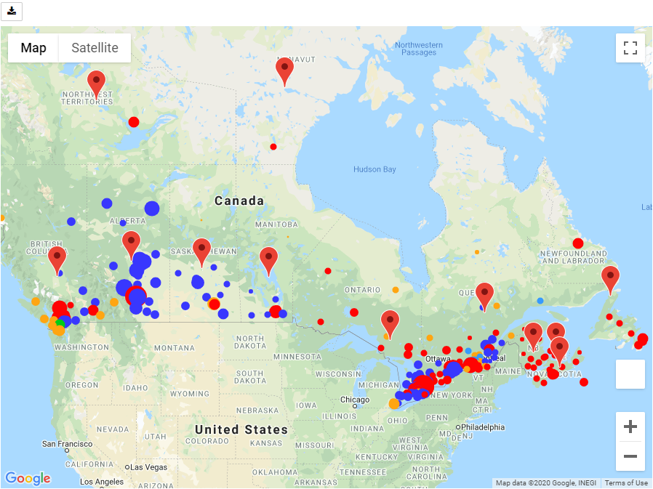
Elections on the Google Maps

Slide 2
Legend: Political Parties Colors
Liberal Party of Canada
Conservative Party of Canada
New Democratic Party
Bloc Québécois
Green Party of Canada

Slide 3

Legend: Per Capita Income
$16,740 to $23,100
$23,100 to $29,460
$29,460 to $35,800
$35,800 to $42,180
$42,180 to $48,540
$48,540 to $54,900
$54,900 to $61,260
$61,260 to $67,600
$67,600 to $73,980
$73,980 to $80,340

Slide 4
Map Data Preparation (optional)
Stats Canada: FED Borders 2013 (GML)
Coordinate Systems: NAD83 vs. WGS84
Converter Web API: epsg.io
Other Data Sources:
Elections Canada: election results and population data
CRA: income data per FED
Presentation:
Symbol layer for FED data
Marker layer for Province info boxes

